Slide 1
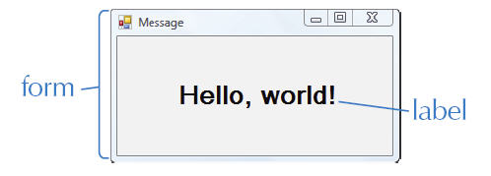
Chapter 2 Visual Basic Interface
Notes:
A Visual Basic application contains a form and typically at least one label.

Slide 2
Chapter 2 Windows GUI
A GUI is a graphical user interface.
The interface is what appears on the screen when an application is running.
A GUI is event-driven, which means it executes code in response to an event.
An event can be an interaction from the user, such as a button click.
Notes:
Compare GUI with a 2D project = poster they did in Middle School.
You add things to the big poster: pictures, text… You have to choose colors, placement, alignment, fonts…
Same with GUI when you change properties.
Differences: GUI is interactive, you can correct easily, easy to store.

Slide 3
Chapter 2 The Visual Basic 2010 IDE
Notes:
The Visual Basic 2010 Integrated Development Environment (IDE) contains a Start Page, menu bar, and toolbar.

Slide 4
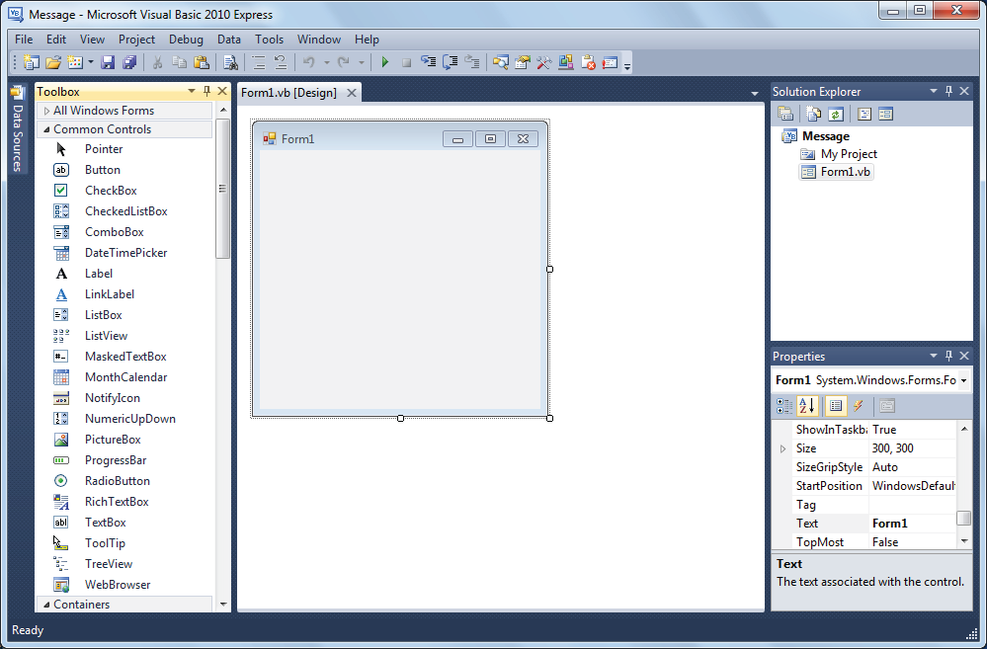
Chapter 2 The Design Window
Notes:
The Design window displays the application interface where objects are added, deleted, and sized.
The IDE also contains a Toolbox with controls that are grouped for easy access.
The Solution Explorer window in the IDE is used to switch between the Design and Code windows (the Code window is discussed later in the text).
The Properties Window (also discussed later in the text), lists the properties of a selected object on the application interface.

Slide 5
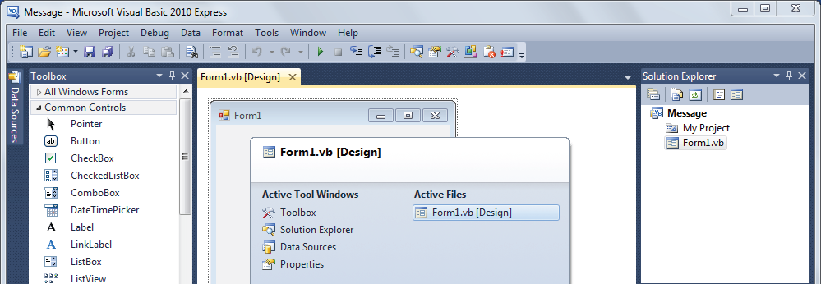
Chapter 2 The IDE Navigator
Notes:
The IDE Navigator is used to switch between open files.

Slide 6
Chapter 2 The Windows Form
A graphical object that contains a title bar, system menu, and Maximize, Minimize, and Close buttons.
To change the form size, click the form and then drag a handle.
A form has properties that define its appearance, behavior, position, and other attributes.
The Text property defines the text in the form's title bar.
Notes:
Exercises 1, 2 ( Address, School ) -> give Call Center application when user calls, database app takes Caller ID ( between first and second ring ) and searches the database. Before the agent answers the phone they have a pop up window ( like Address ) with all the info about customer ( Name, Address, Product, History, Existing tickets…)

Slide 7
Chapter 2 The Label Control
(Name) should begin with lbl.
Text is the text displayed in the label.
Font defines the font name, style, and size of the label text.
Autosize sizes the label to fit its text. Can be set to False so that the label size does not change.
TextAlign sets the alignment of the text within the label.
Notes:
Think of labels as reserved space on the Form to display data ( text or numbers ).
Electronic Displays on highways have a programmer’s name ( example ED234 equivalent to (Name)) but they display useful messages -> equivalent to Text
Give students handouts ( or put scanned pages on web site ) with Ch_2 Exercises: 1/Address, 2/School first. 1 period for each.
Teach how to save:
Save all
Use Google drive and Flash Memory
Grading Criteria:
- Comments, Naming, Functionality

Slide 8
Chapter 2 The MenuStrip Control
A component that is displayed in the component tray at the bottom of the Design window.
Each menu name typed is a MenuItem with the properties:
(Name) which is assigned automatically.
Text is the menu or command name.

Slide 9
Chapter 2 Program Code
A set of instructions called statements that tell the computer how to perform tasks.
OOP code is organized into classes, each defining a set of data and actions.
Program code for a Visual Basic application is typed into the Code window.
A form has a class named Form1 where code is added to tell the computer how to respond to events.

Slide 10
Chapter 2 The Event Procedure
A procedure is a block of code written to perform a specific task.
An event procedure, or event handler, performs a task in response to user interaction with an object.
A Click event procedure executes in response to a mouse click.
Event procedures are added to the Form1 class to add functionality to an application.

Slide 11
Chapter 2 The Code Window

Slide 12
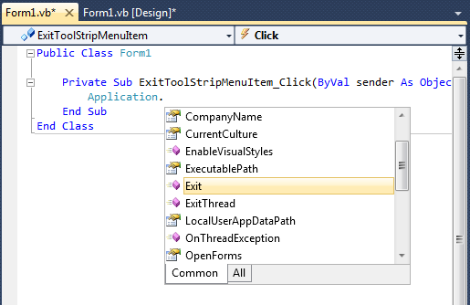
Chapter 2 Using IntelliSense

Slide 13
Chapter 2 The Application Class
A built-in Visual Basic class.
Includes the Exit method. A method is a named set of statements that perform a specific task.
Methods of a class are accessed using the a dot (.).
The Application.Exit() statement stops program execution.

Slide 14
Chapter 2 Assignment Statements
A statement that includes the equal sign (=) operator.
Assignment can be used to change a property value at run time. This type of statement takes the form:
Me.Object.Property = Value
Me refers to the Form object, Object is the name of the control object, Property is the name of the property, and Value is the new property value.

Slide 15
Chapter 2 The RadioButton Control
(Name) should begin with rad.
Text is the text next to the button.
Checked is set to True if the button should be displayed as selected. Only one radio button in a group can be selected at a time.
Note: radio buttons must be grouped in a GroupBox to work properly.
Notes:
A Click event procedure is usually coded for each RadioButton object.
Write/project HelloWorldInternational on page 50

Slide 16
Chapter 2 The GroupBox Control
(Name) should begin with grp.
Text is the text displayed at the top of the group box.
Notes:
There are typically no event procedures associated with a group box.

Slide 17
Chapter 2 Comments
Used to explain and clarify code for other programmers.
Have no effect on the way an application runs.
Begin with a single quotation mark (').
Inline comments are comments placed on the same line as a statement. These should be used where additional explanation may be needed.
Multiline comments, sometimes called comment blocks, appear at the beginning of a program line.

Slide 18
Chapter 2 Arithmetic Operators and Numeric Expressions
Arithmetic operators are used to form numeric expressions.
Built-in arithmetic operators include:
^ (exponentiation)
* (multiplication)
/ (division)
+ (addition)
– (subtraction).
Notes:
A numeric expression can be used anywhere a number is allowed.
It is good programming style to use parentheses when there is any ambiguity or question about the numeric expression so a programmer reading the code will not have any doubts about what is intended.

Slide 19
Chapter 2 Operator Precedence
Operators in Visual Basic have the following precedence:
1. exponentiation
2. multiplication and division
3. addition and subtraction
Operators of the same precedence are evaluated in order from left to right. For example, multiplication is performed first, then division, and finally addition:
5 + 6 * 4 / 2 = 17
Notes:
PEMDAS = Parentheses Exponentiation Multiplication Division Addition Subtraction

Slide 20
Chapter 2 Changing the Order of Operations
The order in which operators are evaluated can be changed by using parentheses. For example, addition is performed first, then multiplication, and finally division:
(5 + 6) * 4 / 2 = 22

Slide 21
Chapter 2 The Button Control
(Name) should begin with btn.
Text is the text displayed on the button.
Notes:
A Click event procedure is usually associated with a button object.
Write/Project Calculations page 52->together with the students.

Slide 22
Chapter 2 Code Conventions
Control objects should be given a descriptive name that begins with an appropriate prefix.
Begin object property assignment statements with Me.
Use comments to include information such as the programmer's name and the date.
Comments should be used wherever code may be ambiguous, but not reiterate what is clear from the code.
Statements in a procedure should be indented.
Notes:
Code conventions are a set of guidelines for writing an application. Code conventions can make modifying and maintaining code faster, easier, and less expensive.
Why name control objects with prefix and descriptive name?
What are the Comment types?Why comments?
Why indent?
Control Objects recap with students:
Input Prefix Output
MenuStrip mnu
lbl Label
Button btn
GroupBox grp
RadioButton rad

